Slide 1
PA History Society
“Add your Name here”

Slide 2
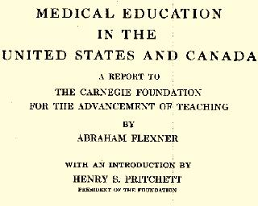
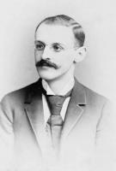
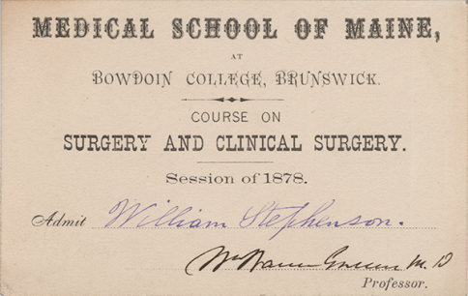
The Flexner Report Impact on Medical Education
Aftermath of 1910 Report
Abraham Flexner
Notes:
The root cause of the problem that spurn the PA profession in the 1960s began many years prior. Financed by a group of physicians, educators, and philanthropists, Abraham Flexner visited every medical school in the United States and Canada to assess their standards of education. In the aftermath of his report, more than half of all American medical schools merged or closed by 1935. Medical school curriculums became more standardized, lengthened and academically entrenched in science. Only a few schools were left that predominately educated women and African-Americans. During this time, standards for hospital care also were developed, improving patient care and outcomes. Teaching hospitals emerged and by 1942 provided clinical sites for training in 15 medical and surgical specialties.
So overall, this was a step in the right direction to improve the education and competence of physicians. However, as we know sometimes good intentions can have bad consequences. Women and people of color were basically denied the opportunity to become physicians. By the 1960s, the medical profession was 94% white males. In addition, the American Medical Association (AMA) used the Flexner Report (1910) on medical education to gain JURISDICTION over who could practice medicine in the United States. By limiting the number of medical schools and students enrolled and urging states to enact restrictive medical practice laws, organized medicine lost its ability to quickly respond to increased demands for health care services. This inability to meet demand became exacerbated after World War Two (WWII) as the nation’s population and wealth increased dramatically.

Slide 3
Post-War America from 1945-1965
From 1945 to 1960 the USA saw a 250% increase in Gross Domestic Product (GDP) resulting in increased family wealth and buying capacity
By 1960, 135 million Americans had employee or other third party health care insurance coverage
Major technological and scientific breakthroughs occurred during this time
1960s begins period of civil unrest in the USA
Notes:
Now, lets pick up our story at the end of the second world war. Remember, the USA and other countries are just emerging from a great depression when war breaks out in Asia in 1937 with Japan invading China and in Europe in 1939 when Germany invades Poland. During the war, the USA became an industrial giant and the benefactor of countries destroyed by war and its consequences. Americans prospered and use employer or other third party health insurance to gain access to health care services improved by advances in technological innovations and scientific breakthroughs. In spite of the “Cold War” with the Soviet Union, America is at its height in productivity and prestige by the 1960s. However, if history teaches us anything, it is “nothing last for ever.”
Prosperity, social inequities and an unpopular war bring civil unrest in the 1960s – segregation is no longer to be tolerated, women and migrant workers want equal rights and citizens begin to question their leaders about an ever continuing and escalating war in Vietnam. Healthcare becomes seen as a right and there are growing demands for the federal government to intervene to make sure all Americans have access to healthcare services.

Slide 4
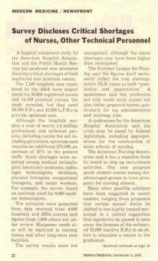
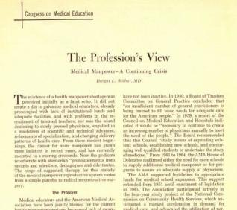
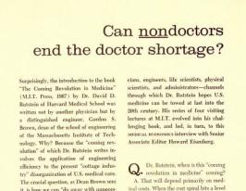
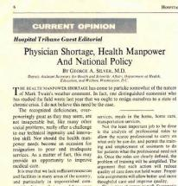
Setting the Stage for a Social Innovation
As physicians and hospitals struggled to meet the high end demands in the marketplace, their ability to deliver accessible, affordable and quality health care services to the lower end of the marketplace waned.
1959
US Surgeon General identifies a national shortage of medically trained personnel.
Notes:
By the 1960’s, there was a shortage of all types of health providers. Demand was greater than supply.
How could this low end – or straightforward - need for primary care services be met?

Slide 5
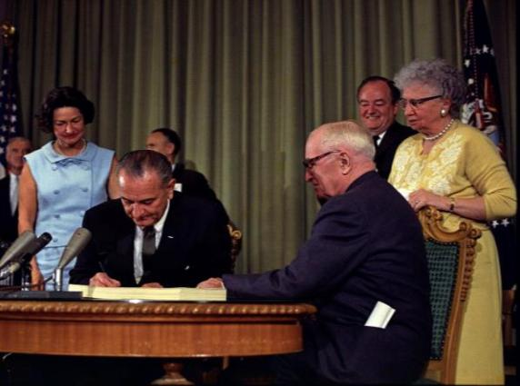
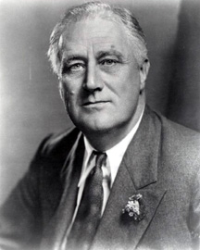
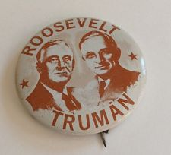
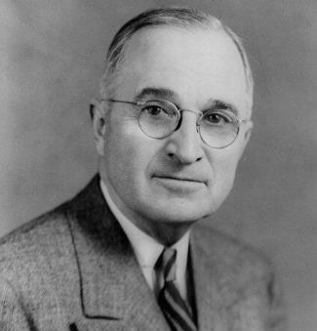
Setting the Stage for a Social Innovation
Demand for medical services was already running ahead of Supply (trained personnel) when President Johnson signed Medicare Legislation in 1965. Nineteen million individuals signed up for Medicare during its first year.
LBJ signs Medicare Act 1965
Increasing Medical School enrollments would be expensive and would take 10 to 20 years to have an impact.
Was there another Solution?
Notes:
Attempts by President Franklin Roosevelt during the 30’s and President Harry Truman during the 40’s to develop national health insurance plans failed because conservative politicians viewed socialized medicine as ‘un-American.’ They were joined in their opposition by the American Medical Association and their allied health care organizations believing NHI would jeopardize “freedom-of-trade” and limit patients’ rights to choose their doctors.
By the 1960s, employer-sponsored health insurance represented the principal way in which Americans received health care insurance. Because they could not afford single subscriber premiums, the elderly, poor and disabled became disenfranchised until the federal government intervened by establishing Medicare and Medicaid programs in 1965.

Slide 6
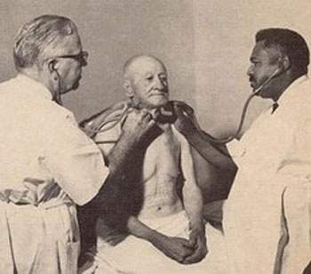
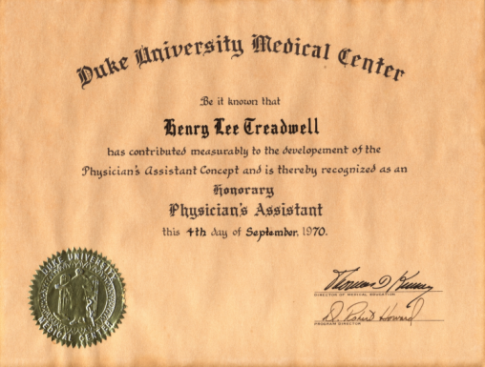
One Doctor’s Solution to a Growing Demand
for Health Care Services, 1950-1960s
Treadwell is made an
Honorary PA in 1970 by the
Duke University PA Program
Dr. Amos Johnson and Buddy Treadwell
Notes:
To help with his personal workload, Dr. Amos H. Johnson trained over time Henry "Buddy" Treadwell, his office assistant, as a doctor’s assistant to work in his rural-based general practice in Garland, NC. This practice exposed Dr. Eugene Stead, Jr. and general medicine residents at Duke University to the “doctor’s assistant model” that would later become institutionalized and advocated as a solution for the plight of overworked physicians.
The Duke PA Program made Treadwell an honorary PA in 1970.
Treadwell soon retired from practice after the death of Dr. Johnson in 1975.

Slide 7
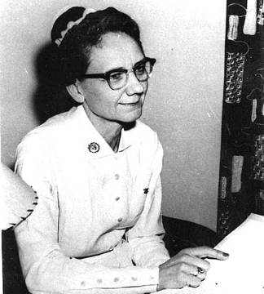
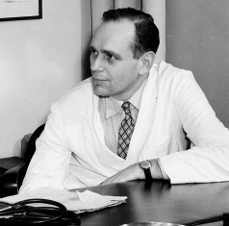
Attempt to Educate Advanced Clinical
Skilled Nurses, 1958
Thelma Ingles, RN and Eugene Stead, Jr., MD’s failure to gain nursing leadership’s acceptance of clinical roles for nurses opened the door for the formal education for physician assistants.
Photographs of Ingles and Stead are courtesy of the Duke University Medical Center Archives
Notes:
Another possible solution was to expand the clinical skills of nurses so they could help physicians take care of seriously ill hospitalized patients. Nurse Educator, Thelma Ingles, and Dr. Eugene Stead, Jr. developed a master’s degree advanced clinical nursing program at Duke University in the late 1950s. Although successful, the program was denied accreditation by the National League of Nursing and closed. The idea of a hybrid nurse-physician was ahead of its time and the male dominated medical profession and the female dominated nursing profession were distancing themselves from each other – both were undergoing shortages and nursing was trying to improve its professional image. Natalie Holt, MD explains all this in her insightful article, Confusion’s Masterpiece: The Development of the Physician Assistant Profession that appeared in the Bulletin of the History of Medicine in 1998.

Slide 8
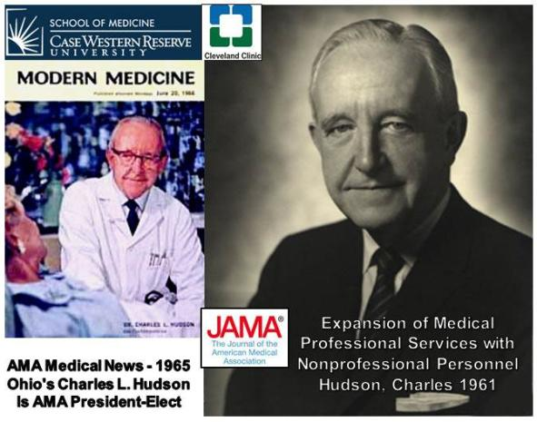
Exchange of Ideas and Values: A Novel Solution
Presented to the American Medical Association, 1961
Charles Hudson, MD in the Journal of the American Medical Association, calls for the training of a "mid-level" provider to assist doctors from a new source of health manpower - such as former military corpsmen and medics.
Notes:
One novel solution put forward by Dr. Charles Hudson to the AMA was to use “nonprofessional” (i.e.. Non-physician providers) to expand medical services. Because of the shortage of nursing and allied health personnel, he suggested finding a new source of individuals to be recruited for this purpose. He cited the use of military corpsmen by the Armed Forces, i.e., taking high school graduates and training them to help provide medical, nursing and other types of health care services to enlisted personnel.

Slide 9
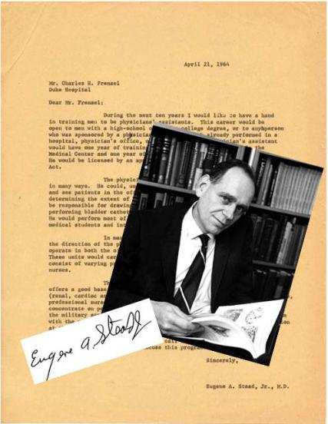
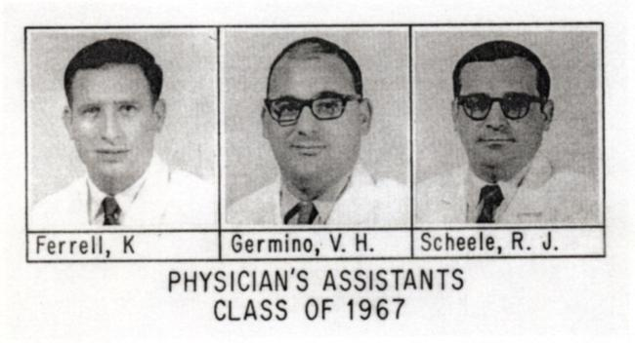
Training Former Military Corpsmen as Physician Assistants, 1964
Eugene A. Stead, Jr., MD sent a letter to Duke University Hospital Administrator, Charles H. Frenzel, stating his intention to develop a program for the “physician’s assistant” using former military corpsmen as the first students.
Notes:
In 1964, Stead took the initiative of developing a formalized program to educate physician's assistants. By that time, the Duke University Hospital had hired former military corpsmen to serve as clinical technicians. Stead believed they would make excellent students for his 2-year program. With NHI funding, he started the program with four full-time and 5 part-time students in 1965. The program was first based in the Department of Medicine but was soon transferred to a newly created department of Community Health Science, chaired by Dr. E. Harvey Estes, Jr. To some extent, the curriculum was modeled after a fast track model used by Stead when he was at Emory University to train MDs during WWII and the newly revised curriculum at the Duke University Medical School that had students complete their basic medical science courses the first year, followed by clinical rotations their second year, and then two years of advanced science and clinical rotations the third and fourth years. So the PA curriculum was similar to that of the medical students during the first two years of school.

Slide 10
Training Former Military Corpsmen and Medics as MEDEX, 1969
Richard Smith, MD, launches the MEDEX program at the University of Washington, Seattle, WA, in partnership with the Washington State Medical Association.
Photograph of Dr. Smith (front, left) with first Class of MEDEX graduates courtesy of Northwest MEDEX PA Program,
University of Washington.
Notes:
The MEDEX (medical extension) program is designed to rapidly deploy ex-military corpsmen to rural primary care practices throughout the Northwest. Unlike the Duke Model, students are primarily trained within the community by their precepting physician who plans to hire the MEDEX after graduation. Clinical algorithms are used to teach MEDEX students clinical practice.

Slide 11
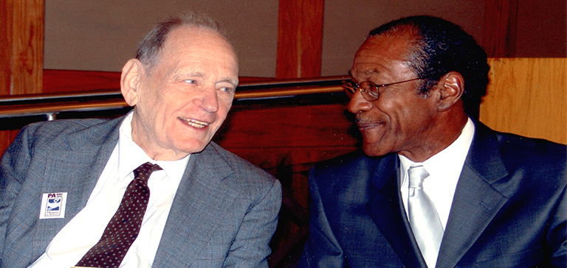
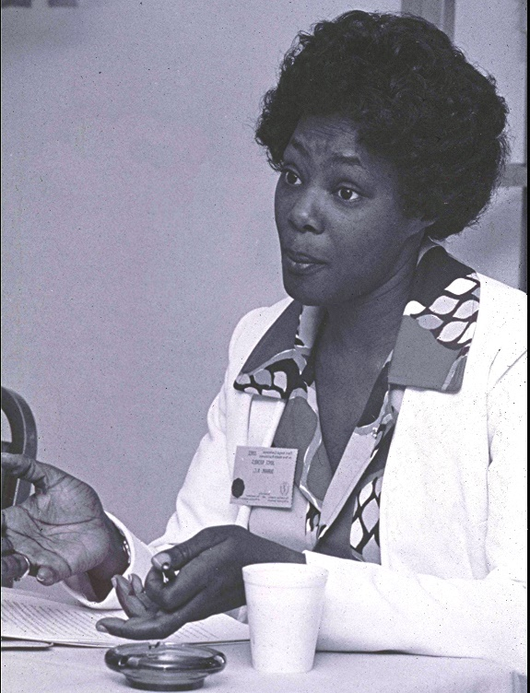
Pioneers who shaped the Role
and Identity of Physician Assistants
Dr. Eugene Stead & Prentiss Harrison
PA Day, 2003
Joyce Nichols
First Female PA
Notes:
As the nation’s first African American PA, Prentiss Harrison helped pioneer the profession.
As a student and 1968 graduate of the Duke University PA Program, he helped educate African American physicians about the PA concept.
Prentiss worked closely with Earl Echard, John Davis, Steve Turnipseed and Joyce Nichols to establish the AAPA minorities’ affair committee in the early 1970s.
Joyce Nichols is the first woman to be formally educated as a physician assistant (PA). She also happens to be the first African-American woman to practice as a PA. Joyce was working as a licensed practical nurse (LPN) at Duke University when Dr. Eugene A. Stead, Jr. established his 2-yr PA educational program in 1965.
Joyce had to overcome a number of obstacles to gain entrance into the program -- She was a woman; she did not have a corpsmen background; she was an African-American; and she had little money to pay for her education.
She was persistent and gradually won the faculty’s confidence and support and entered and graduated from the Duke PA Program in 1970.

Slide 12
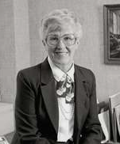
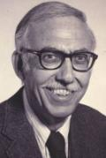
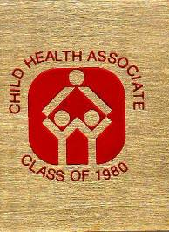
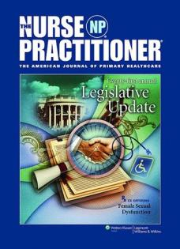
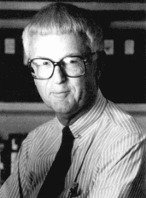
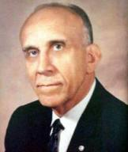
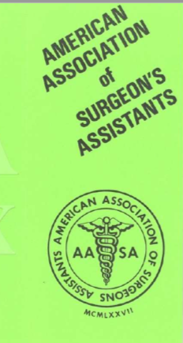
Shifts in Roles and Relationships
Other
Innovators
Loretta Ford RN and Henry Silver Pediatric Nurse Practitioner/ Child Health Associate
John Kirklin
Surgeon’s Assistant
Hu C. Myers
Physician’s Assistants
Baccalaureate Program
Notes:
In 1965, the same year Stead launched his PA program, Nurse educator Dr. Loretta Ford and Dr. Henry Silver launched the first successful Pediatric Nurse Practitioner Program at the University of Colorado. They succeeded where Stead and Ingles failed, primarily by bypassing nursing, and having the program accredited by the American Academy of Pediatrics. Dr. Ford is now recognized as the founder of the Nurse Practitioner Profession.
Silver later establish a physician assistant type program that provided the opportunity for non-nurses to become Child Health Associates. It became the first PA-type program to offer a master’s degree to its graduates.
Dr. John Kirklin saw the need for surgeon’s assistants and founded the first formal program for this purpose at the University of Alabama, Birmingham. Dr. Hu Myers believed that for PAs to be successful, they would need academic credentials and founded the first baccalaureate degree granting program at Alderson–Broadus College in Philippi, WVA.
All these prototype PA model programs eventually modified their curriculums so that they could meet the same accreditation standards making their graduates eligible to be nationally certified.

Slide 13
Internal Value Networks formed to Support
the PA Profession as a Social Innovation
Four Pillars of the PA Profession
Notes:
The national PA organizations come on the scene:
American Academy of Physician Assistants (AAPA) was founded in 1968 and evolved into a unified voice for physician assistants and physician assistant students.
The Physician Assistant Education Association (PAEA) was founded in 1972 as the Association of Physician Assistant Programs (APAP).
The Accreditation Review Commission on Education for the Physician Assistant (ARC-PA) was established in 1972 as the Joint Review Committee for Educational Programs for the Assistant to Primary Care Physician (JRC-PA) to oversee the accreditation process. The ARC-PA is an independent accrediting body authorized to accredit qualified PA educational programs in the USA.
The National Board of Medical Examiners (NBME) developed and administered the first national certifying examination for the assistant to the primary care physician in 1972.
The National Commission on Certification of Physician Assistants (NCCPA) was incorporated opened its office in 1975.
NCCPA is the only credentialing organization for physician assistants in the United States.

Slide 14
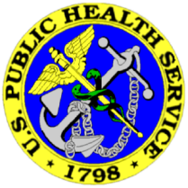
Supporting the PA Profession as a
Social Innovation
AMA (and other physician specialty organizations), NBME, AHA, AAMC, FSMB
Veterans Administration Medical Centers
Support Education
Hospital Privileges
Utilization Patterns
US Public Health Service
US Department of Defense
Health Workforce Alliances
Political Action Committee Alliances
Pharmaceutical Industry
Private Foundations
Consumer Health Advocacies
Notes:
The importance of external value networks can not be underestimated. The above are only a few examples on the national level. (see list on slide)
The Veterans Administration was supportive because the first students and graduates were mostly former corpsmen, i.e., veterans. So many VA hospitals and medical centers affiliated with medical schools, provided funding, space and in-kind support for the development of PA programs. Today, the VA is the largest single employer of PAs with close to 2000 PAs working in their ranks.
The Indian Health Service and Federal Bureau of Prisons provide great opportunities for PAs in the USPHS. In 2006, the USPHS appointed Rear Admiral Mike Milner as its first PA flag officer.
As industrial exhibitors, the pharmaceutical industry has supported the AAPA national conferences for years; also through advertisements in trade magazines and newsletters; by sponsoring recognition awards, and so forth. Now that PAs can prescribe in all states, PAs are an integral group to be marketed for products.

Slide 15
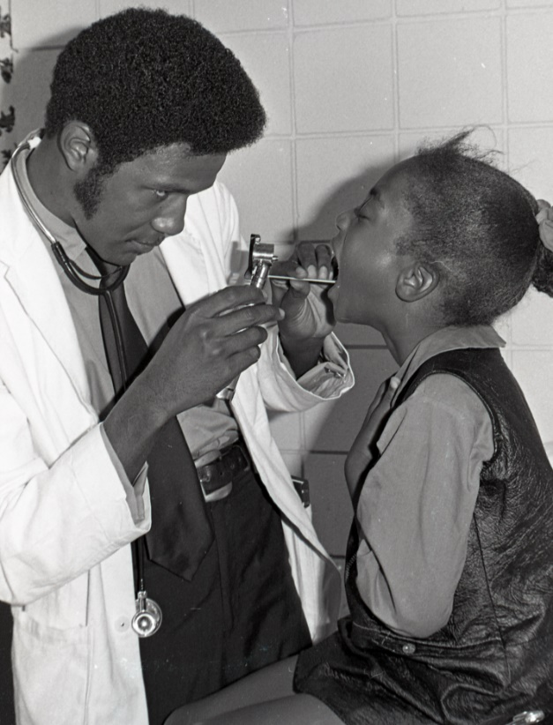
PAs as a Novel Social Innovation – Examples
Building Alaska pipeline
Rural Satellite Clinics
Alternative to House Staff
First Assist in Surgery
Military PAs
Public Health Service PAs
EMR Triage/Primary Care
Urgent Care
Walk-in Minute Clinics
Patient Centered Medical Care Centers
Prentiss Harrison checking
patient at Bragtown Clinic, 1971.
Photograph courtesy of Duke University Archives.
Notes:
Let’s now look at some examples of how PAs and NPs have become a social innovation in the fields of medicine and nursing. (see examples in slide).
Pipeline contractors could not hire MDs to man outlying clinics; so they recruited PAs to do so; at less cost. PAs who worked on the pipeline were able to pay off student loans and develop saving account after one year of service.
Health care services extended to outlying communities via satellite clinics. Similar clinics soon established within inner city centers. Rural Health Act helped reimburse for PA rendered services. Advocates for these clinics pushed for the development of pharmaceutical formularies allowing PAs to prescribe from an approved list of drugs, opening the door for prescriptive privileges a few years later.
At Montefiore Medical Center in Bronx, NY, Gliedman and Rosen recruited PAs to substitute for surgical house staff as a way to decrease number of surgeon’s being trained. Based upon their success, they established the first postgradute residency in surgery for PAs in 1971. Other hospitals have established residency programs and PAs are being hired as “hospitalist” as well as physicians.
Most of us now know about the walk-in or so called minute clinics provided at CVS and Walgreens. Not only can you be seen quickly by a NP or PA, but you can get your prescription filled at the same location.
The Affordable Care Act is providing new opportunities to form Patient Centered Medical Home collaborative practice models to address both primary care and subspecialist needs – oriented toward preventive health care services.

Slide 16
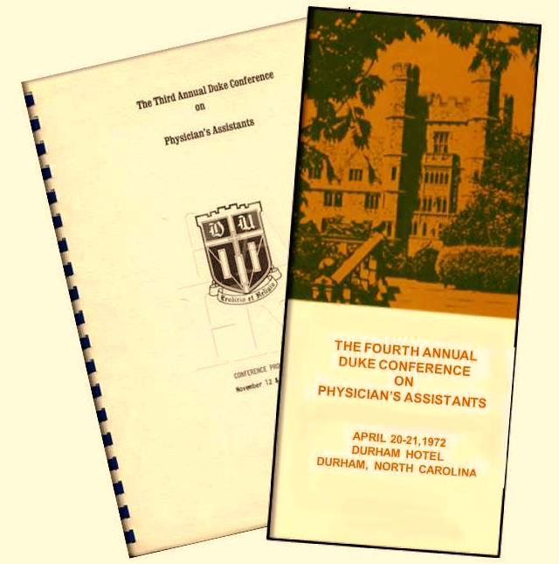
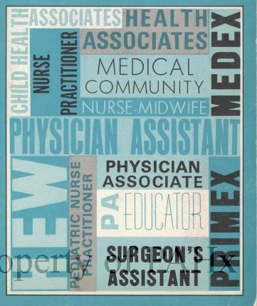
Exchange of Ideas and Values: Duke Conferences and National Conferences
Notes:
Four conferences were held at Duke University between 1968 and 1972. Participants included educators and leaders from organized medicine, federal agencies, private foundations, health policy makers and lawyers. Topics included curriculum development, accreditation and certification standards and enactment of PA enabling legislation. With the emergence of PA, MEDEX and NP programs throughout the USA, it was desired to hold future conferences in a different location and to extend invitations to a larger and more diverse group of participants, generically called “New Health Practitioners.” The first national meeting was held at the Sheppard Air Force Base in Wichita Falls Texas in 1973.

Slide 17
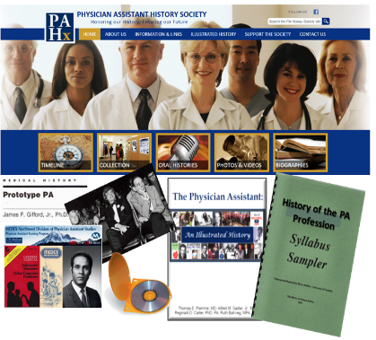
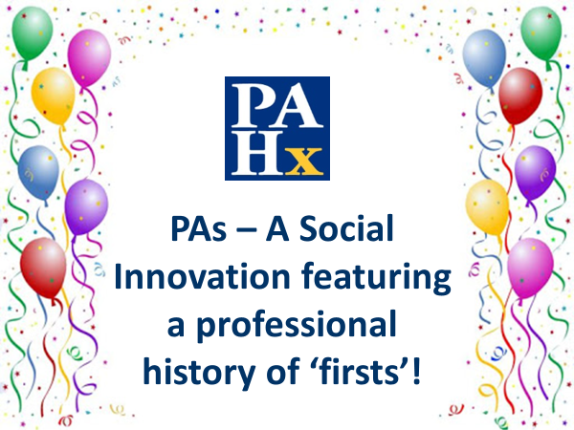
Educational Resources
Let’s Celebrate
The staff promoted the Society’s newest resource, “Anniversary & Celebration Planner”, many times throughout the year to the PA community [260 PA Programs and 110 Constituent Organizations] by email, social media, a PAHx website post and Historical Happenings. As you’ll recall, the planner includes a variety of information for assisting constituents and program with organizing their PA-related special activities such as celebrating major milestones and anniversaries.
The PA History Society offers 3 resources:
Educational Learning Modules
Historian Toolkit
Celebration Planner
Notes:
The Educational Toolkit is 5 learning modules that provide a comprehensive overview of the history of the PA profession; this module includes an Objectives & Goals, Quizzes and an Instructor’s Guide – the perfect resource for teaching the history of the profession
The Historian Toolkit is designed to assist state chapters and PA programs with identifying and organizing their materials to document their own history.
The Celebration & Anniversary Planner includes useful information for planning your state chapter or PA programs special events and anniversaries. It also includes tips for hosting a ‘virtual’ event during these COVID-19 times.

Slide 18
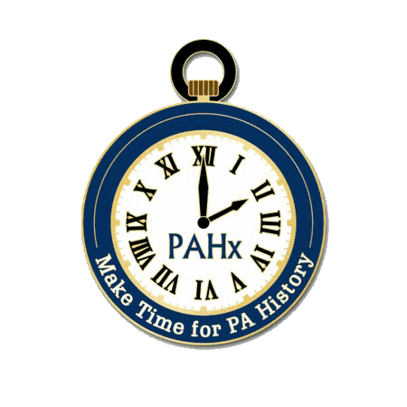
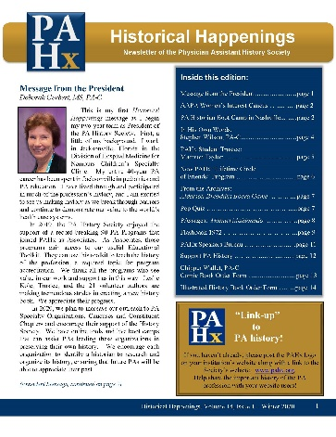
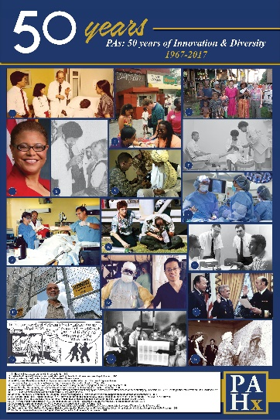
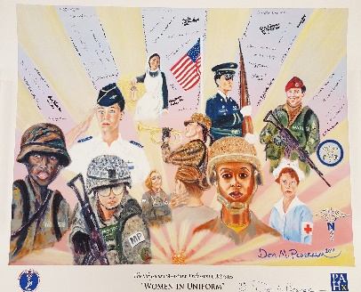
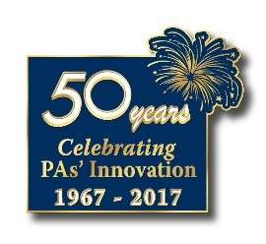
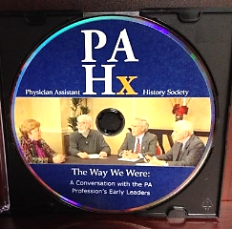
All Things PA History …
Posters & Lapel Pins:
Quarterly newsletter:
Historical Happenings
Educational Resources:
Social Media:
Notes:
The Society fulfills its mission to share the rich history and legacy of the PA profession by developing educational materials and promoting the profession through:
- Posting historical fun facts on social media – Facebook, Twitter, Instagram and a Blog
Publishing a quarterly newsletter with a variety of interesting and relevant articles.
Produced a DVD with the first Board Chairs of the AAPA, PAEA and NCCPA discussing the establishment of these organizations
Compilation of Dr. Steads quotes and philosophy on medical in the little blue book of “Steadisms” titled “Just Say for Me”
Published the history of the profession in a book “The Physician Assistant: An Illustrated History”
The Society is currently in development of a new PA history book
The Society also offers posters and lapel pins!

Slide 19
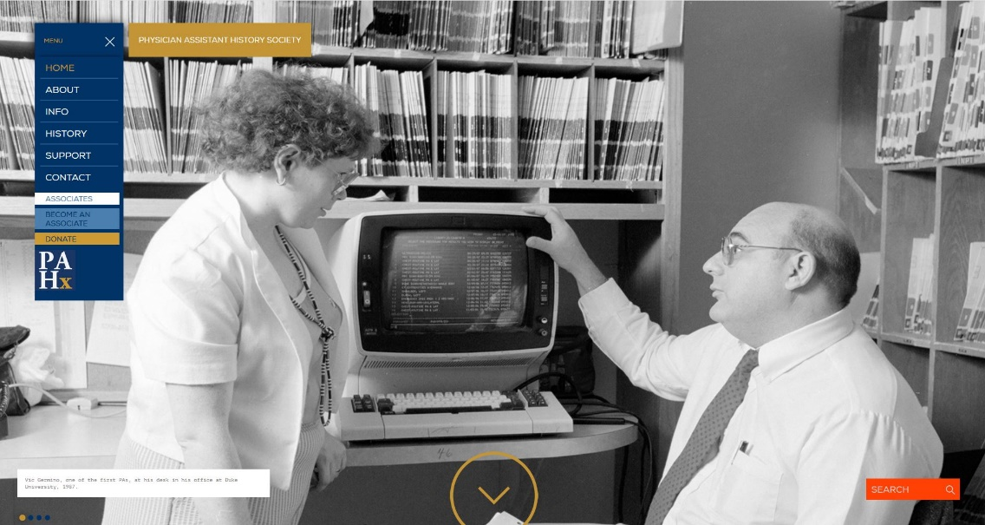
www.pahx.org
Over 53 years of PA history waiting to be explored via our website!
Notes:
The face of the PA History Society is their dynamic website which features their online collections including biographies, photographs, videos, online exhibits, and illustrated timelines of the major events that
have shaped the profession both nationally and abroad.
Also on our website, you can find:
-Information about the Society, their special projects, and archival collections
-Listings of past presidents and chairs of the national PA organizations
-Past sites of the national AAPA and PAEA conferences
-Helpful Links to other PA organizations and medical history websites
-the Society’s quarterly newsletter, “Historical Happenings”
-Information on their educational resources and products
-And information on how to support the Society either through donations, joining their Circle of Friends or by becoming an Associate

Slide 20
Questions and Comments?
The PAHx would love to hear from you:
please email us at contactus@pahx.org

